Slide 1
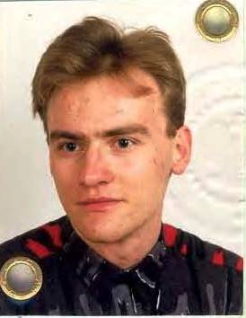
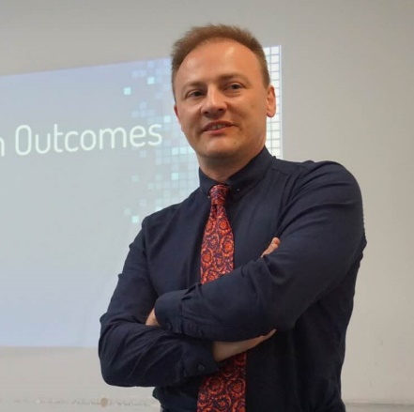
Krzysztof Laudanski
Thank you for being part of LDI
DePartment of Anesthesia and Critical Care

Slide 2
Fun fact vs LDI and I
Krzysztof
Krystoff – 18%
Krzyszztof – 12%
Kryzystof – 18%
Kryzstyof – 7%
Krysztof – 18%
Others – 7%
UBER failure
Laudanski – 8%
Laudanski – 4%
Kris
80%
92%

Slide 3
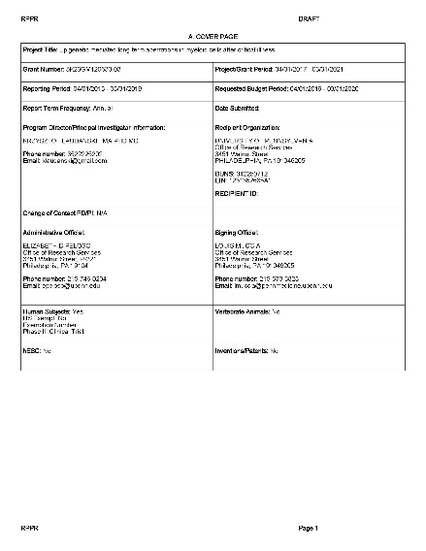
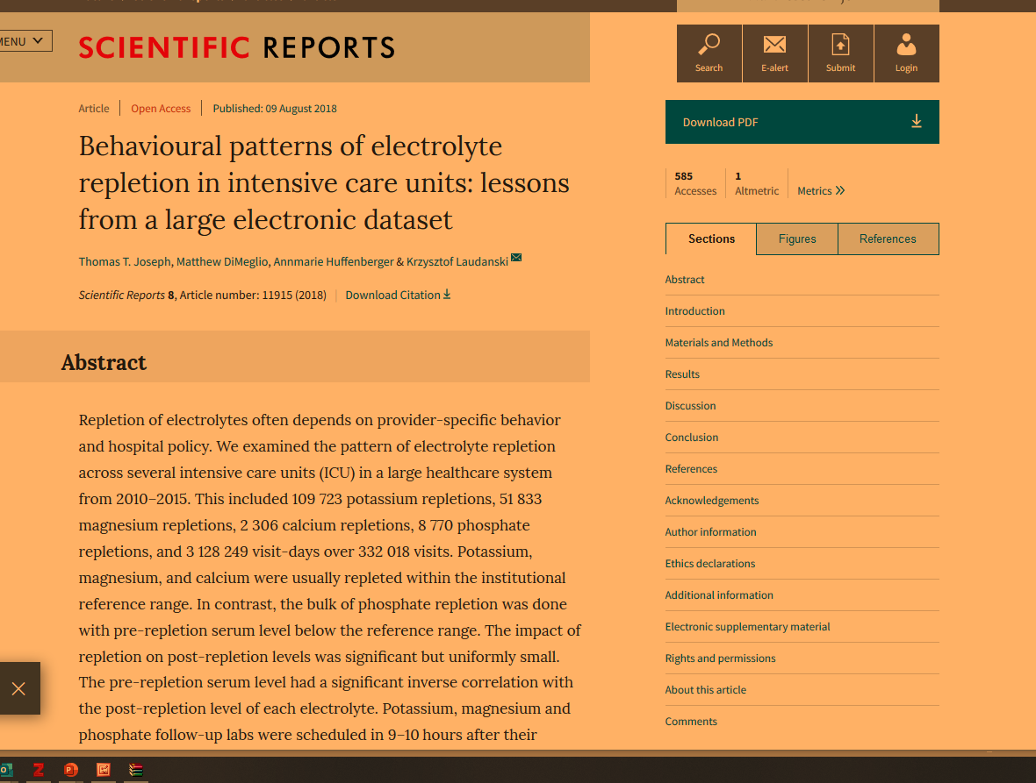
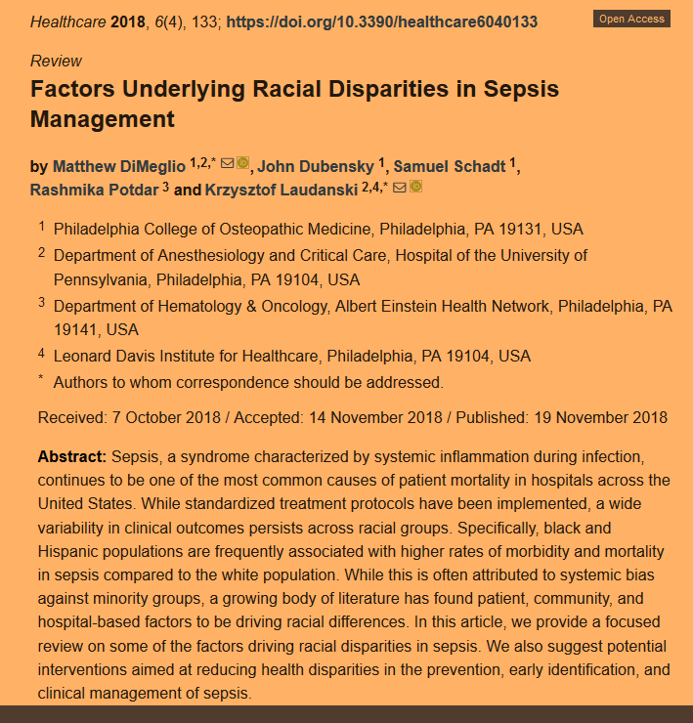
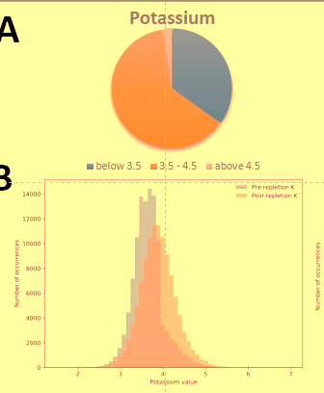
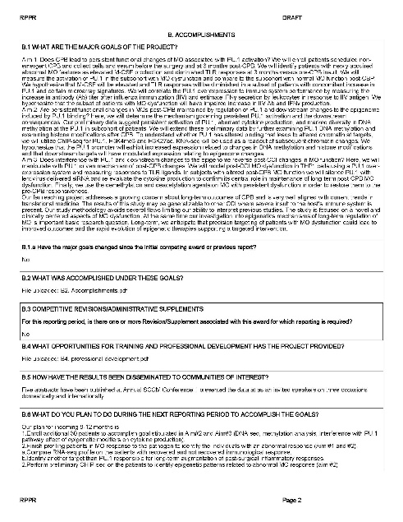
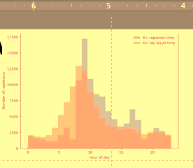
Research
Epigenetic abnormalities of immune system long term after critical care insult
Determinants of providers and patients decision making in healthcare
Disparities in healthcare delivery

